Slide 1
The Nordic Model vs. full decriminalisation
Nordic Model Now!

Slide 2
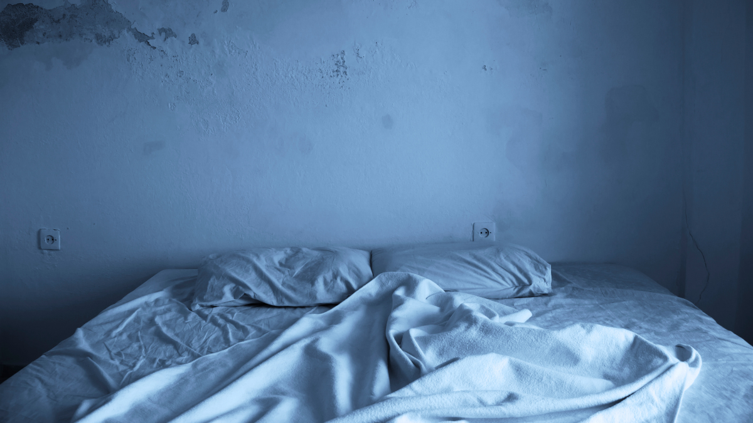
Prostitution
What is it, really?

Slide 3
Emily
“I was sold a complete lie. It’s not easy money. To the buyer, you are nothing more than an object for their consumption, not an actual human being with emotions. You’re expected to just put up with whatever they want to do and say to you. The exchange of money makes them feel entitled to treat you however they like, with no regard for your feelings or consent…”

Slide 4
Harriet
“People think prostitution is about having consensual sex for money. It’s not. Those men don’t want to pay for that. They paid me and then used me however they wanted. I was beaten with objects until I bled; spat at; anally raped; gang raped; passed around at sex parties like a toy, men slipping off their condoms; I was shouted at, threatened, choked, told to look like I enjoyed it or he’d take the money back. I was scared every single second.”

Slide 5
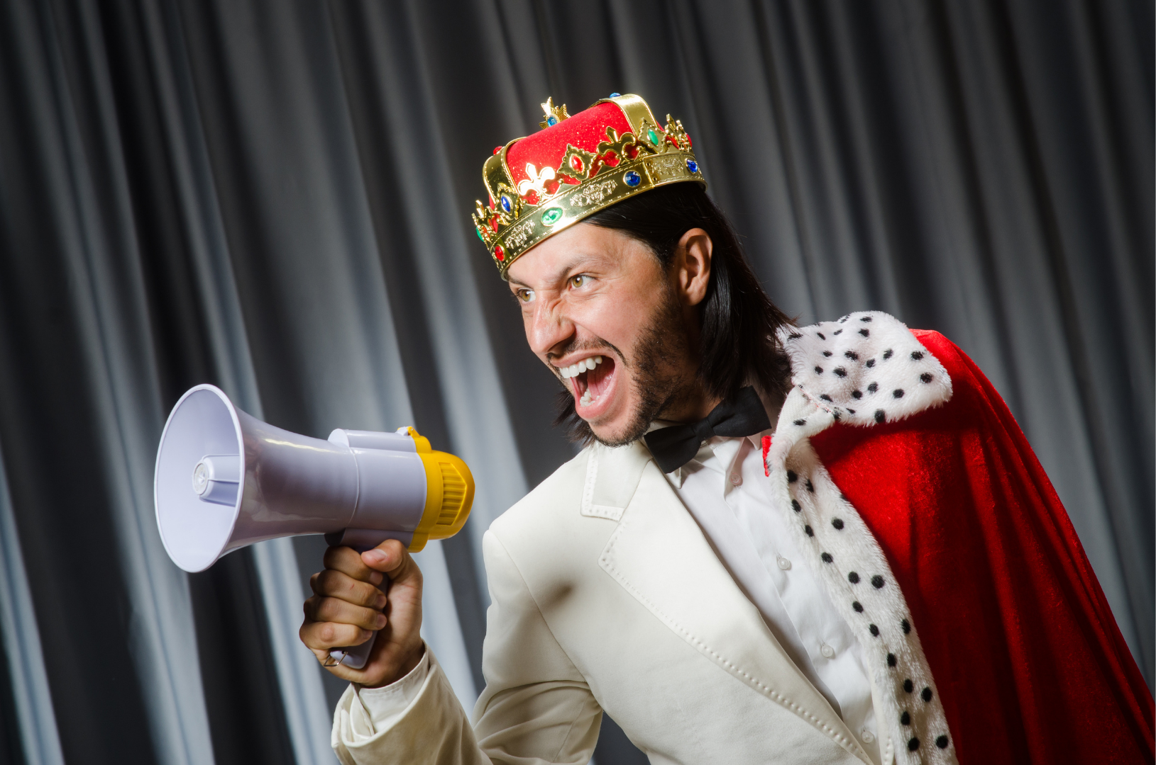
The punter is king

Slide 6
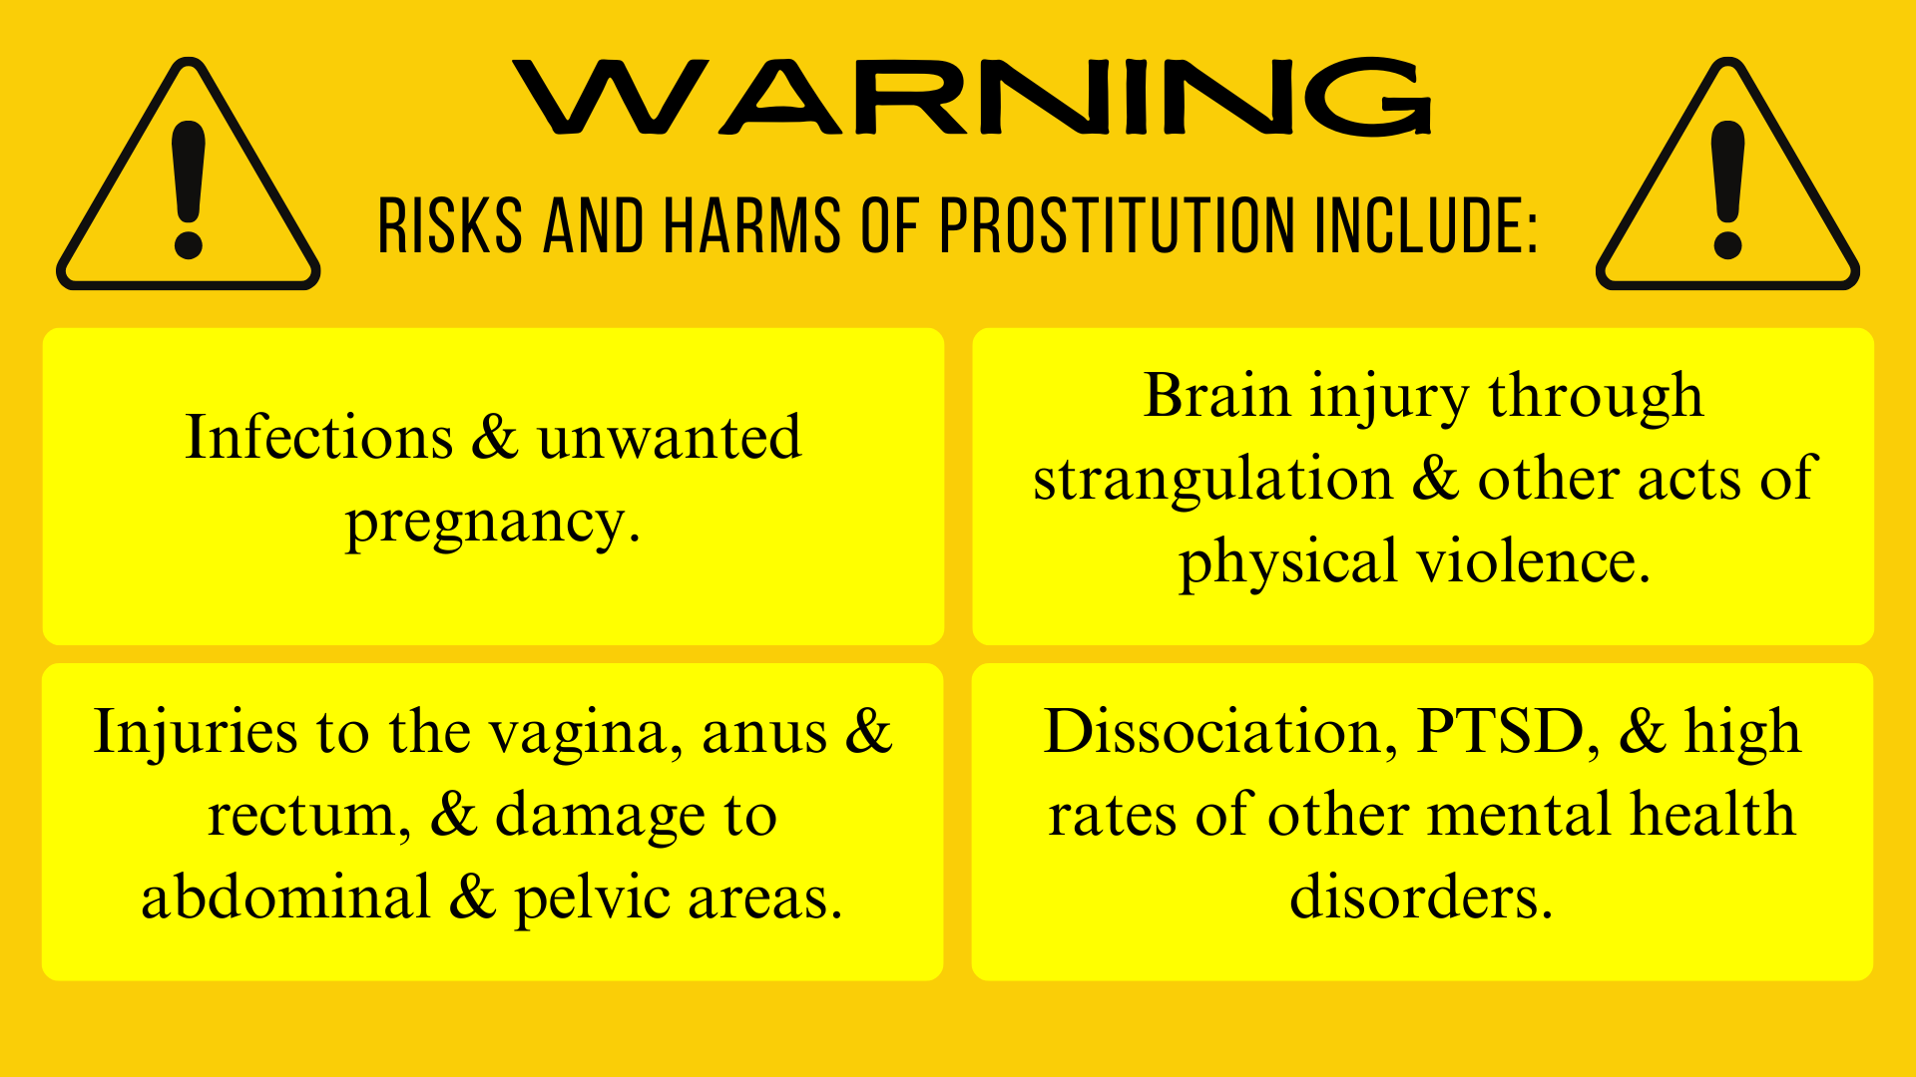

Slide 7

Health & safety

Slide 8
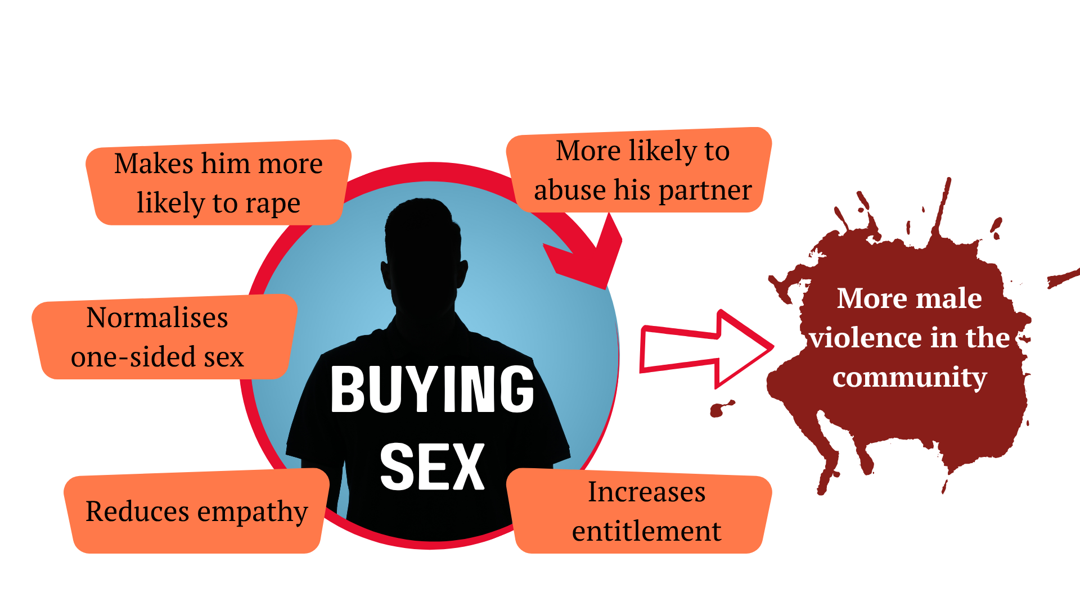
Impact of buying sex

Slide 9
The Nordic Model #1
Also known as the Equality Model.
First introduced in Sweden in 1999, now in several countries.
Recognises prostitution as part of the structural oppression of women and both a cause and consequence of the inequality between the sexes.

Slide 10
The Nordic Model #2
Decriminalises selling sex.
Provides services & genuine routes out of the industry.
Buying sex becomes a criminal offence.
Strong laws against trafficking, pimping & brothel keeping.
Holistic measures incl. education, & training for police.

Slide 11
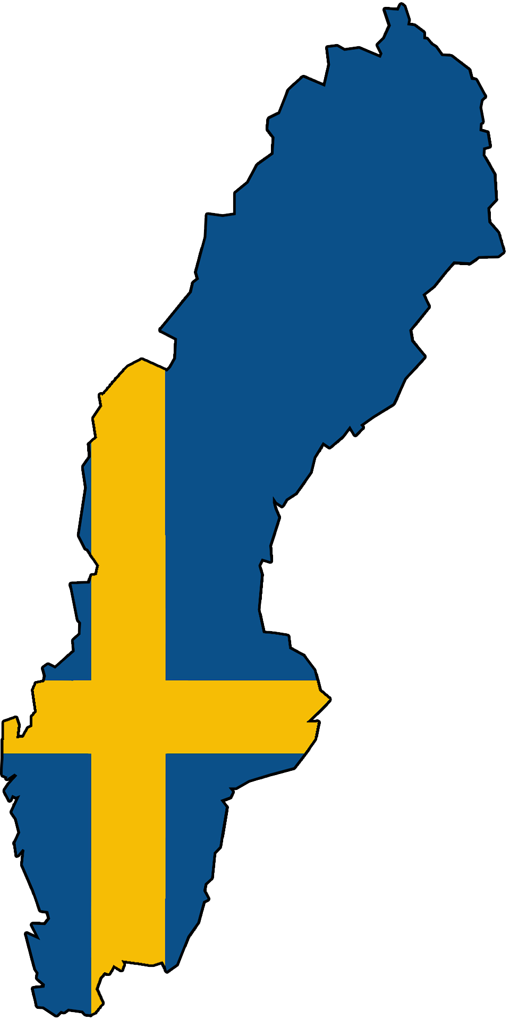
What happened in Sweden?
Decrease in the size of the industry.
No evidence it has gone ‘underground’.
Hostile destination for international traffickers.
A change in the culture and men’s behaviour.
Widespread public support.

Slide 12
Full decriminalisation (decrim)
All aspects of the sex trade, including pimping & brothel keeping, are decriminalised.
No public funding for services to help women exit.
Laws against trafficking are retained but in practice they are hard to enforce – so most sex trafficking goes under the radar.

Slide 13
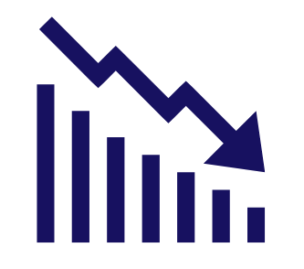

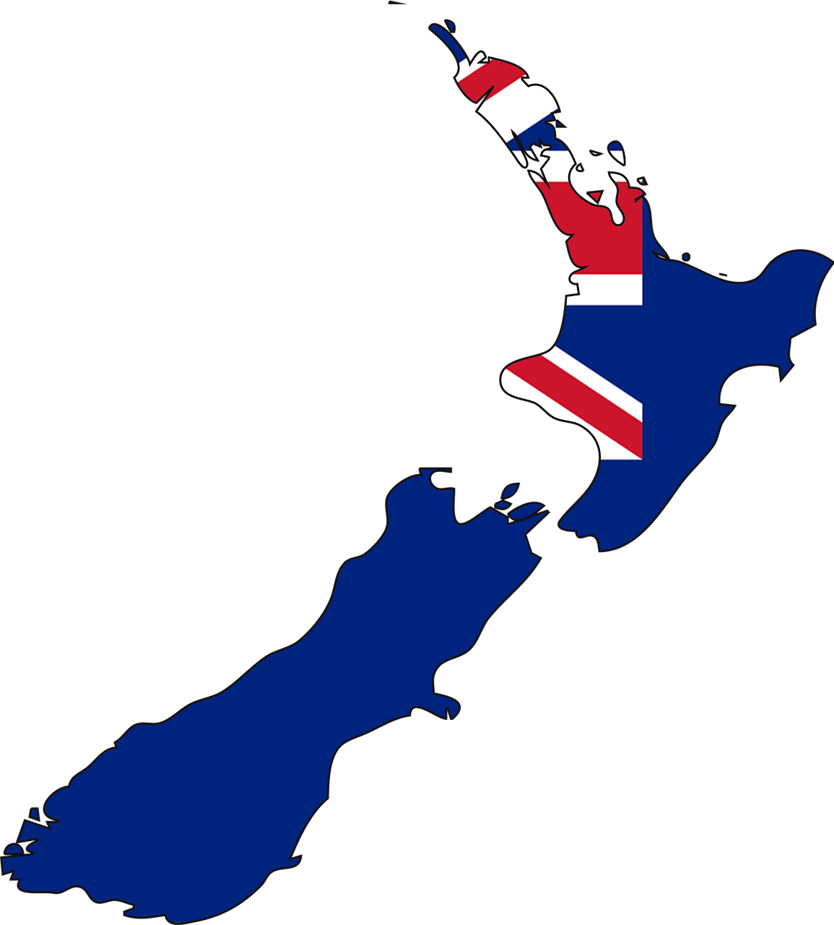


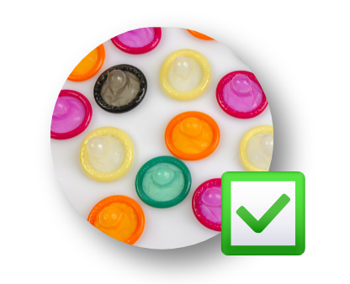
What they CLAIM happened in New Zealand
Decrease in the size of the industry.
Safer for ‘sex workers’.
‘Sex workers’ can refuse clients/services.
Regular inspections of brothels.
Compulsory condom use.

Slide 14




What Actually happened in New Zealand
Rapid increase in the size of the industry.
Violence and coercion remain rife.
It’s not usually possible to refuse clients.
Inspections in 12 years vs >1000 brothels.
Unprotected sex is common.
11

Slide 15
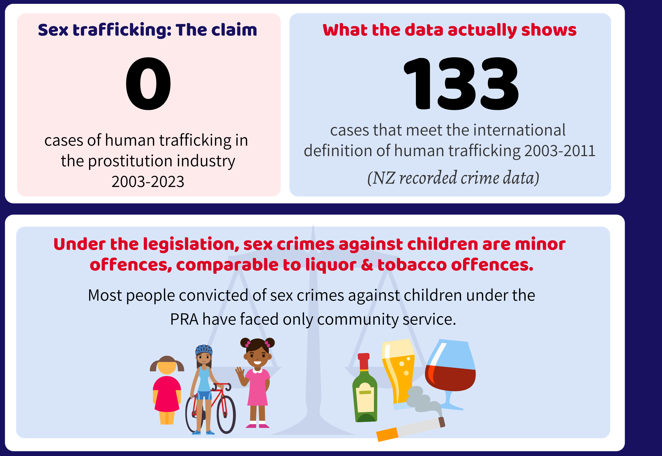

Slide 16


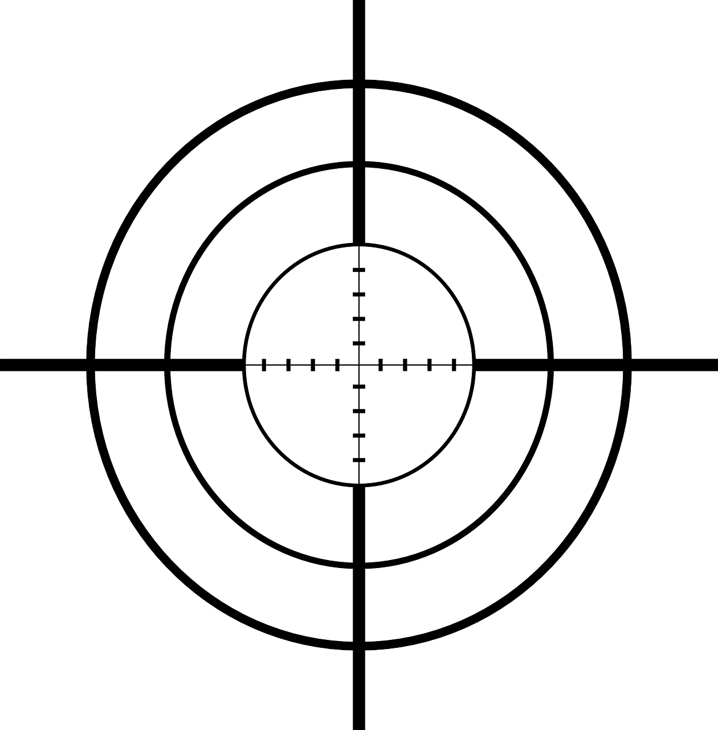
FEATURE
Decrim
Nordic MODEL
Selling sex is legal?
Services, incl. routes out?
Pimping is legal?
Brothels are legal?
Buying sex is legal?
Trafficking effectively legal?

Slide 17



Full decrim vs. legalisation
Germany & the Netherlands both have legalisation.
In theory, legalisation is very different from decrim – but in practice there are many similarities.
Both result in:
A massive increase in the size of the industry.
Mega-brothels that cater to large numbers of punters simultaneously.
Pimps are considered respectable businessmen.

Slide 18
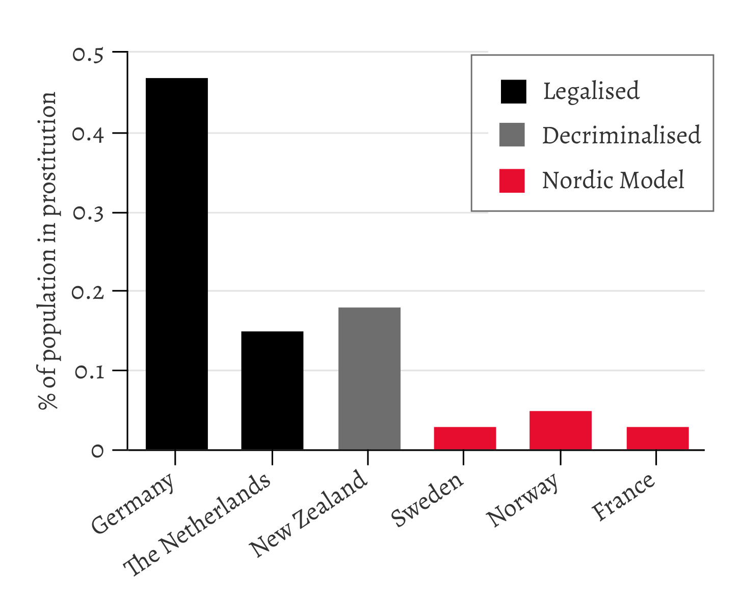
Percentage of population in prostitution

Slide 19
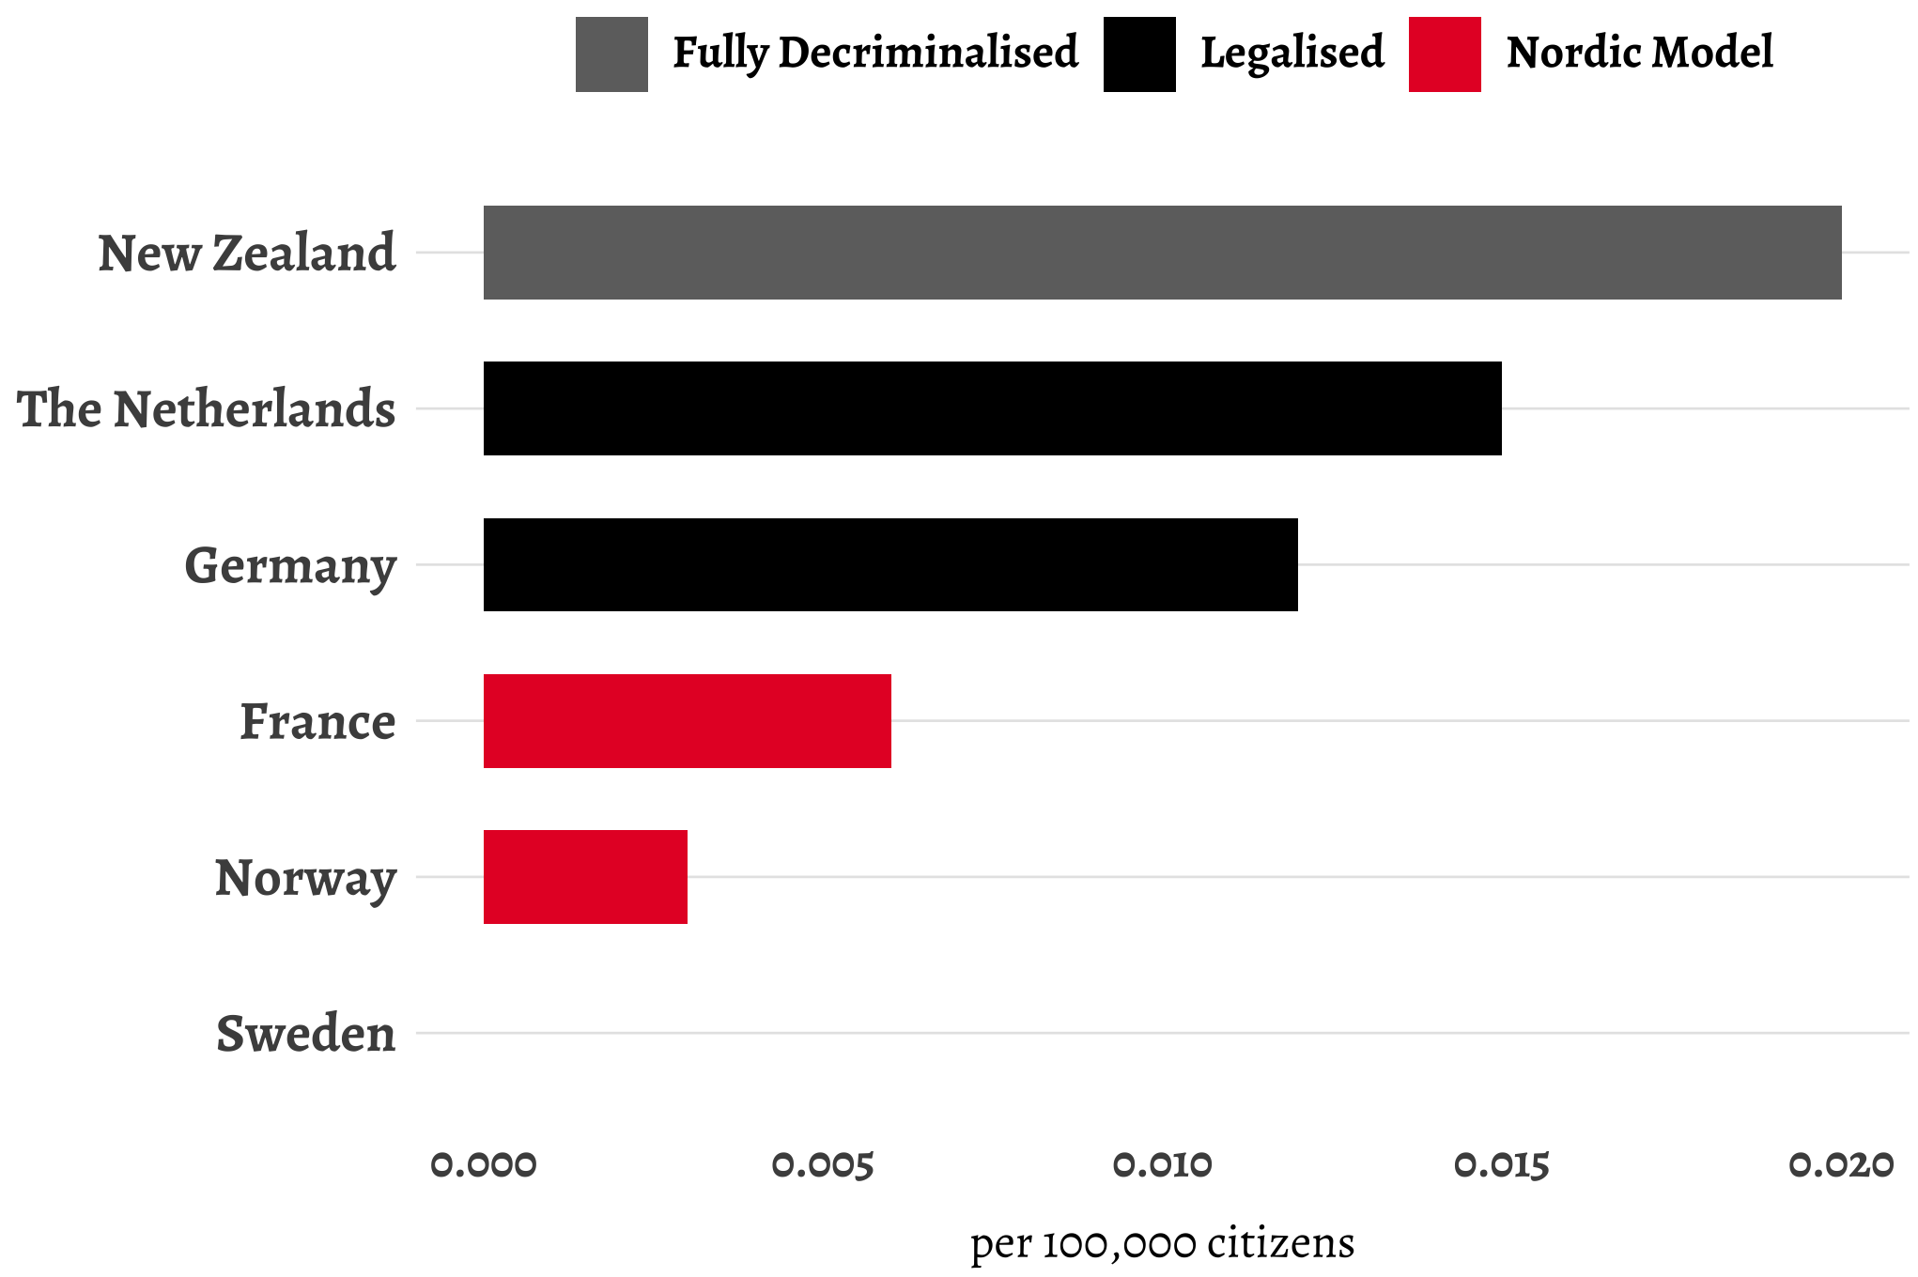
Average annual rate of homicide of prostituted women per 100,000 female population

Slide 20
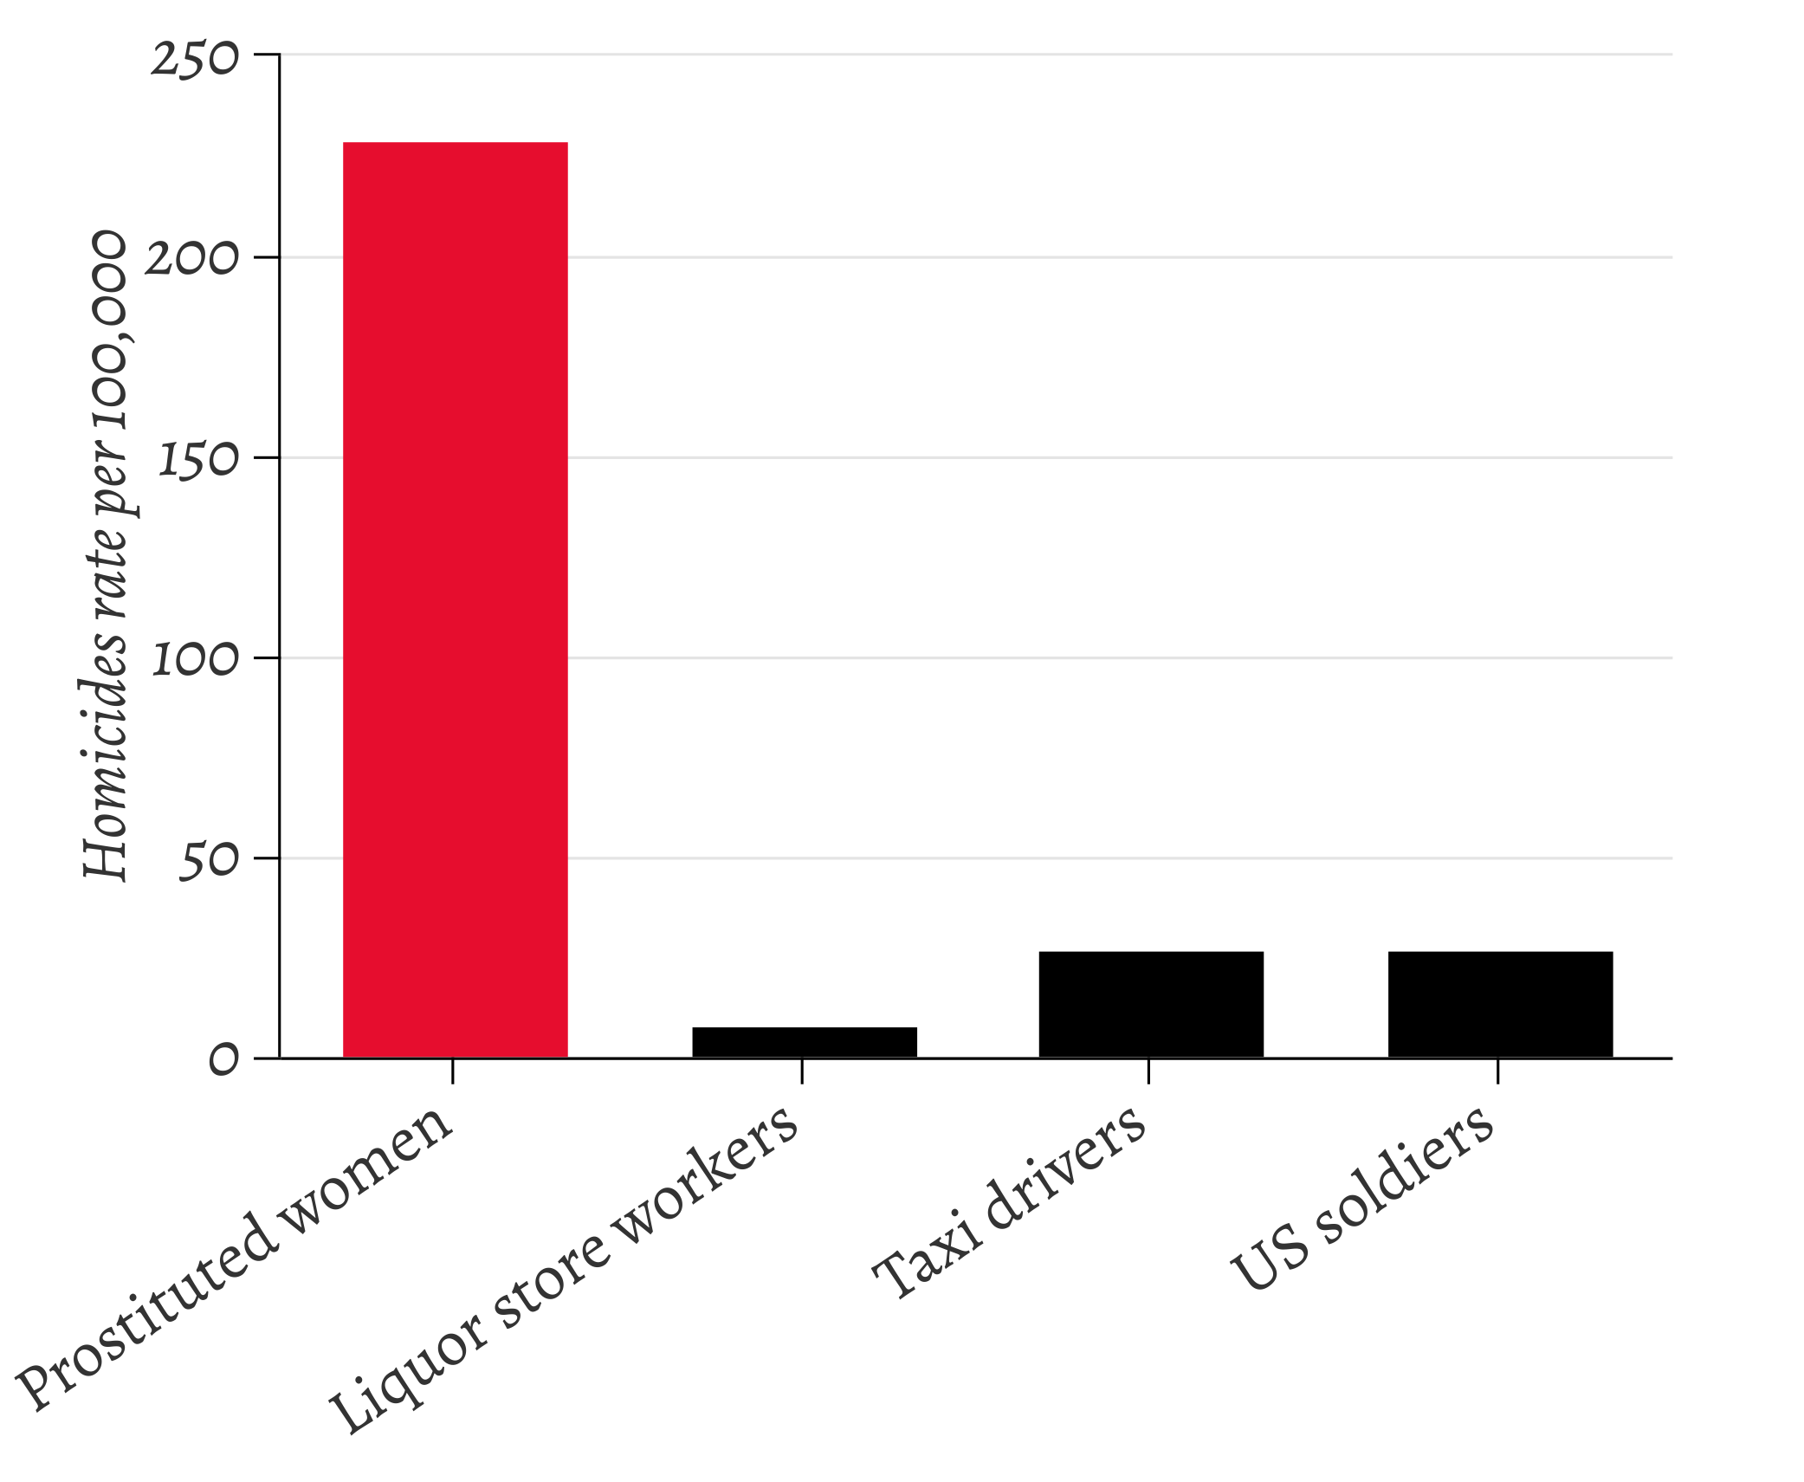
Homicide rates in the most dangerous occupations (US data)

Slide 21

References
https://wp.me/p7kKHz-7ek

Slide 22

Thank you!
https://nordicmodelnow.org
@nordicmodelnow

